Slide 1
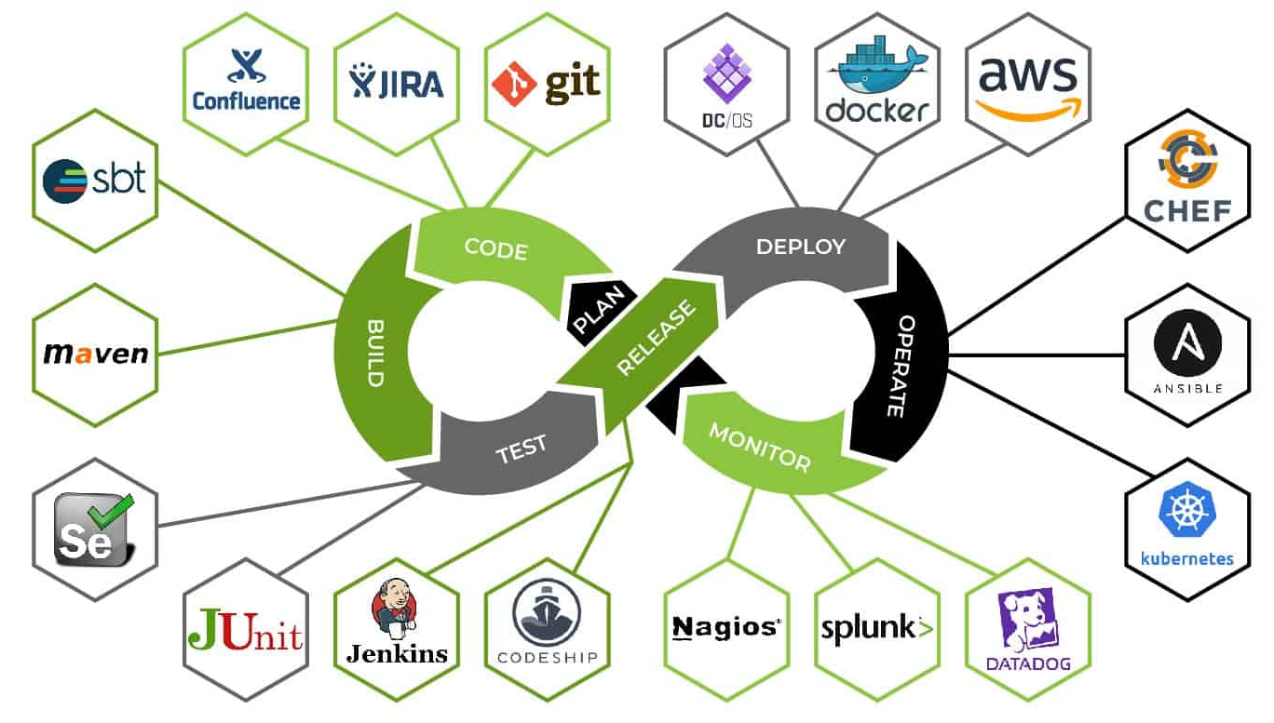
CS489 Final Project
Md Mahbub Hossain
617576

Slide 2

Objectives
Apply knowledge from CS489 through practical project implementation
Build a full-featured e-commerce app, mastering each phase of the SDLC
Showcase skills in job interviews with a portfolio-ready product
Bridge academic learning with real-world application through best practices

Slide 3
Domain
E-Commerce

Slide 4
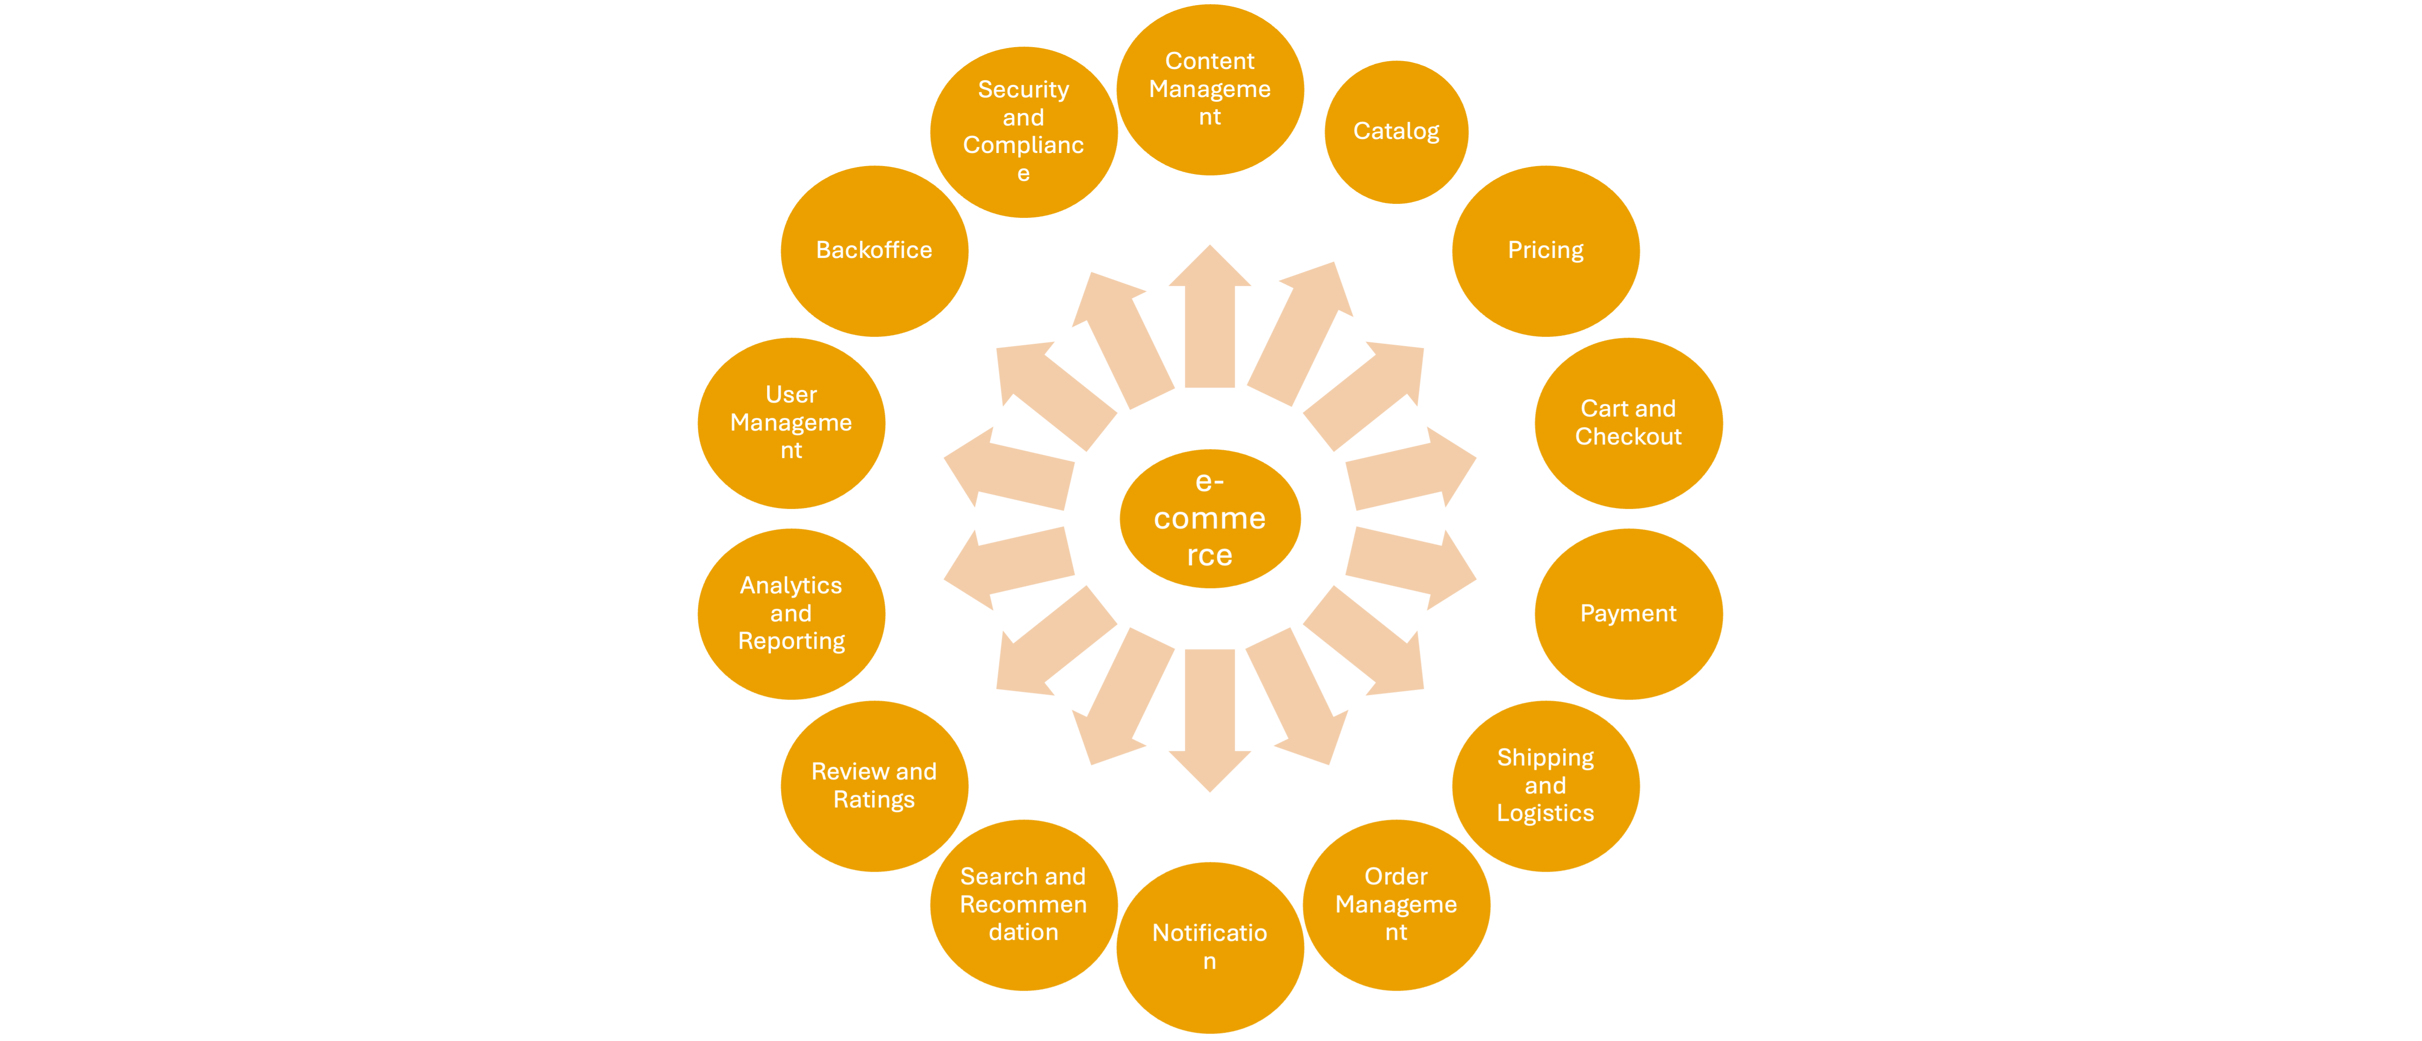
E-Commerce Features
Membership / User Management
Registration, login, password reset
Profile management
Roles & permissions (admin, customer, seller)
Catalog / Inventory Management
Product listing & details
Categories & filters
Stock levels and variants (e.g., color, size)
Pricing Engine
Base prices, discounts, promotional pricing
Region-based or customer-segment pricing
Coupons and vouchers
Cart & Checkout
Add/remove items to/from cart
Save for later, wish list
Address, delivery options

Slide 5
E-Commerce Features
Payment Processing
Payment gateway integration (Stripe, PayPal, etc.)
Support for multiple payment methods
Refunds, failed transaction handling
Shipping / Logistics
Delivery estimation
Shipment tracking
Warehouse handling
Order Management System (OMS)
Order creation, modification, and status tracking
Returns & cancellations
Invoice generation
Notification System
Email & SMS updates
Push notifications
In-app alerts

Slide 6
E-Commerce Features
Search and Recommendations
Search indexing (e.g., Elasticsearch)
Personalized recommendations
Recently viewed, frequently bought together
Reviews & Ratings
Product reviews by users
Moderation & spam control
Ratings aggregation
Analytics & Reporting
Sales dashboards
Customer behavior analytics
Conversion rates

Slide 7
E-Commerce Features
Content Management System (CMS)
Banners, homepage management
Promotional content
SEO metadata management
Admin / Backoffice Tools
Admin dashboards
Role-based content control
Bulk product upload
Security & Compliance
GDPR/CCPA compliance
Token management, Oauth
Activity logging, audit trails

Slide 8
Project Scope

Slide 9
Project Scope
Membership / User Management
Registration, login, password reset
Profile management
Roles & permissions
Scope of Final Project: User Management

Slide 10

Scope Definition: Why User Management?
Foundational Entry Point:
User Management serves as the entry point to the entire e-commerce workflow, initiating the customer journey from registration to order placement.
Security-Critical Functionality:
This module encompasses core security features such as authentication and authorization. It provides an ideal opportunity to apply the security concepts learned in the course, including implementing JWT-based authentication to prevent unauthorized access and fraud.
Microservices-Oriented Design:
In a modern e-commerce system, User Management is often developed as an independent microservice. Its modular nature makes it a self-contained and realistic choice for final project development, reflecting how such systems are built in industry.

Slide 11
Problem Statement
Requirement Analysis
&
Requirements Elicitation

Slide 12
Problem Statement
In modern e-commerce systems, seamless and secure user interaction is foundational to business success. However, many platforms face challenges in managing user identities, securing access, and providing personalized experiences without compromising security or scalability.
The absence of a robust User Management module leads to:
Fragmented authentication processes
Poor user experience due to inconsistent access control
Increased vulnerability to unauthorized access and fraudulent activity
Difficulties in managing user roles and permissions across services
To address these issues, there is a need for a centralized, secure, and scalable User Management solution that can:
Handle user registration, login, profile updates, and password recovery
Ensure secure access through industry-standard authentication mechanisms such as JWT
Manage user roles and permissions to support role-based access control (RBAC)
Integrate seamlessly with other microservices in a distributed architecture
This module will serve as a critical foundation for user identity and access control in the broader e-commerce application.

Slide 13

Use Cases
Major Use Cases for User Management
Register Account
Login
Update Profile
Reset Password
Assign Roles (Admin only)
Authenticate User (System)
Authorize Access (System)
Log Security Events (System)

Slide 14
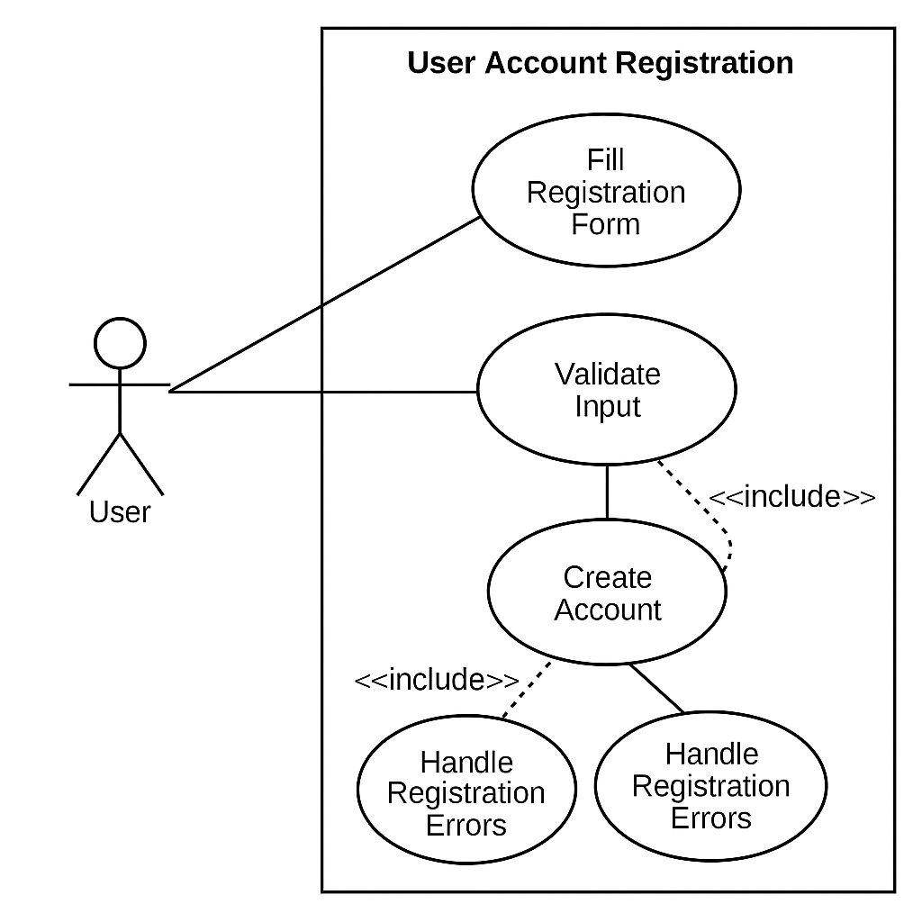
Use Cases

Slide 15
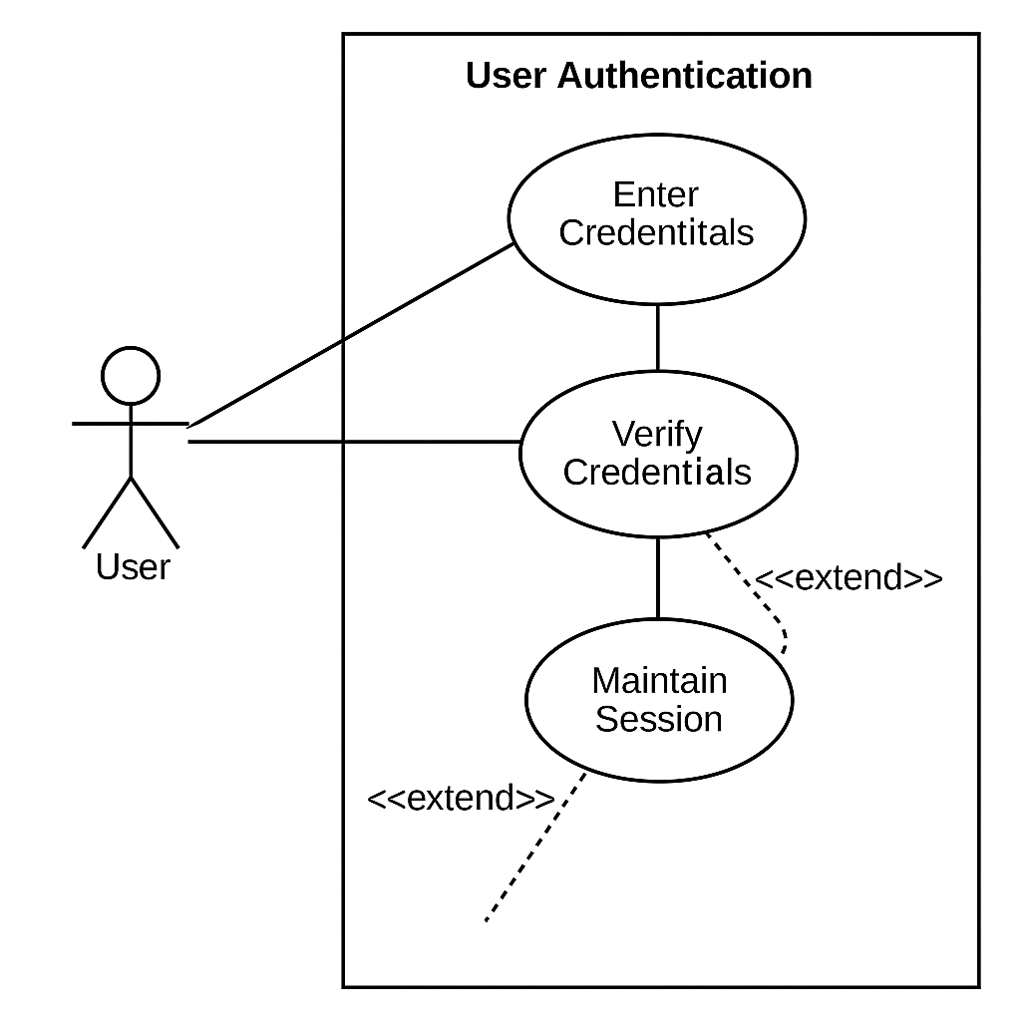
Use Cases

Slide 16
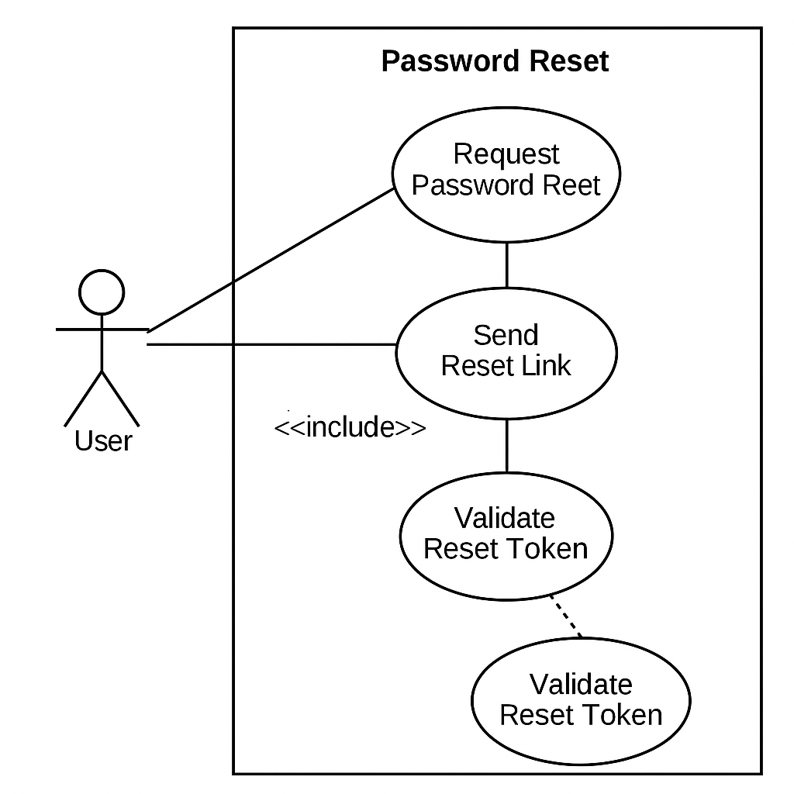
Use Cases

Slide 17
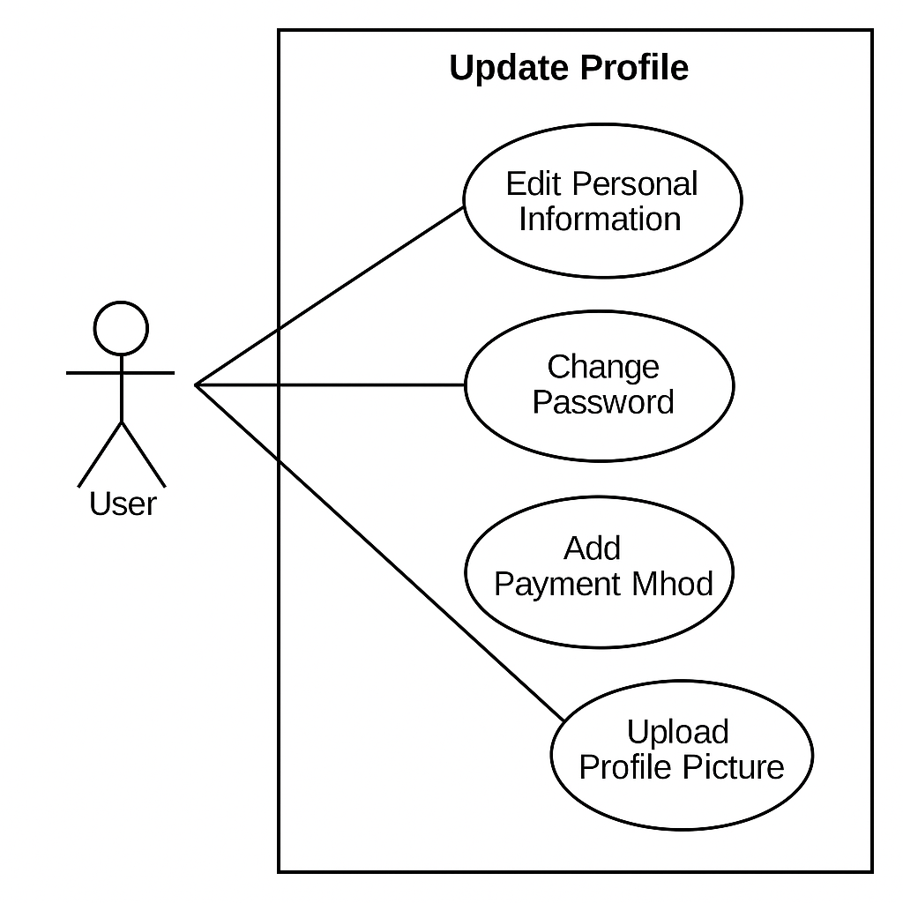
Use Cases

Slide 18
Requirements Elicitation
User Registration and Profile Management
The system must allow users to register by providing necessary details (e.g., name, email, password).
Users must be able to update their profile information securely after authentication.
Secure Authentication and Authorization
The system must authenticate users using secure methods (e.g., username/email and password).
Upon successful authentication, the system must issue a JWT (JSON Web Token) for session management.
The system must validate and authorize user actions based on token validity and assigned roles.
Password Management
The system must allow users to securely reset their passwords via a password recovery process.
Passwords must be securely encrypted and never stored in plain text.
Role-Based Access Control (RBAC)
The system must support different user roles (e.g., Customer, Admin, Seller).
Access to resources must be controlled based on user roles and permissions.

Slide 19
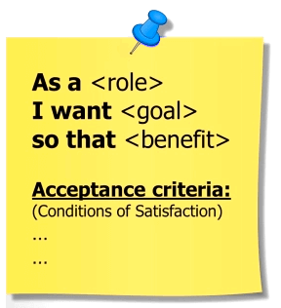
User Stories
1. User Registration and Profile Management
As a new user, I want to register an account by providing my personal information, so that I can start using the e-commerce platform.
As a registered user, I want to update my profile information, so that my account remains accurate and up-to-date.
2. Secure Authentication and Authorization
As a user, I want to log in securely with my credentials, so that I can access my personalized dashboard and services.
As a system administrator, I want the application to issue a secure token (JWT) after successful login, so that user sessions can be managed safely and without server-side state.

Slide 20
User Stories
3. Password Management
As a user, I want to reset my password securely if I forget it, so that I can regain access to my account without contacting support.
As a user, I want my password to be stored securely, so that even if the database is compromised, my password remains protected.
4. Role-Based Access Control (RBAC)
As a system administrator, I want to assign different roles (e.g., Customer, Admin, Seller) to users, so that access to different functionalities is properly controlled.
As a user, I want to access only the resources relevant to my role, so that the system remains secure and manageable.

Slide 21
Design

Slide 22
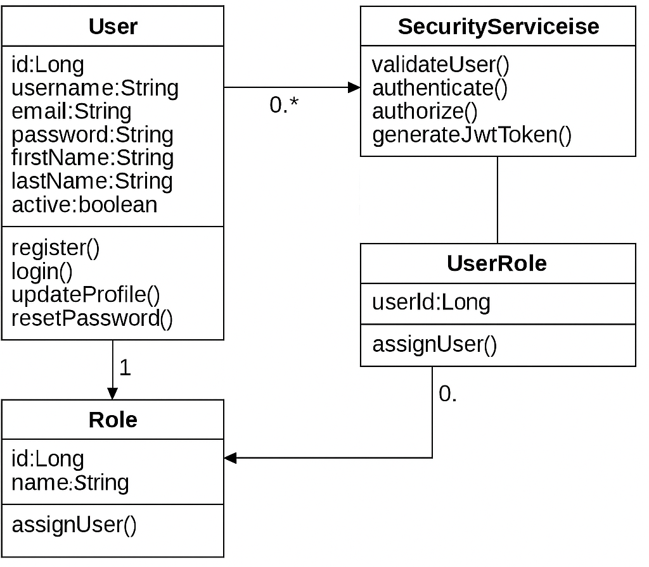
Class Diagram

Slide 23
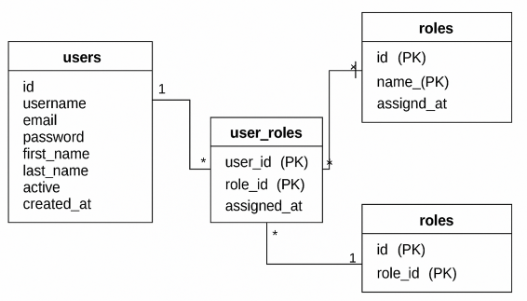
ERD

Slide 24
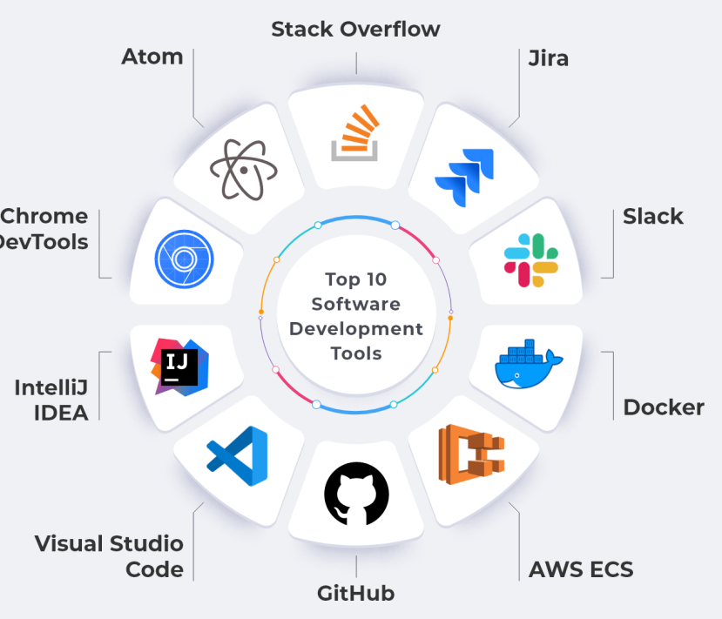
Technology Stack
Backend:
Spring Boot
Security:
Spring Security with JWT token-based authentication
Language:
Java 17+
Build Automation:
Maven
Cloud Deployment:
AWS (EC2)
Database:
MySQL (for user data persistence)
Version Control:
Git and GitHub

Slide 25
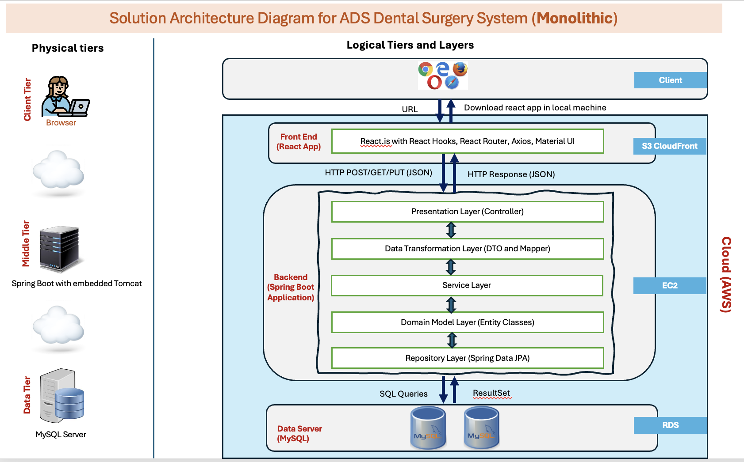
Architecture Diagram

Slide 26
Implementation

Slide 27
Implementation of Technical requirements
1. Validation

Slide 28
Implementation of Technical requirements
2. Security

Slide 29
Implementation of Technical requirements
3. Global Exception

Slide 30
Implementation of Technical requirements
4. Unit Testing

Slide 31
Implementation of Technical requirements
5. Pagination

Slide 32
Implementation of Technical requirements
6. Cloud Deployment

Slide 33
Future Enhancement

Slide 34
List of Future Enhancement
Manage token in server side (Invalidate after logout)
Maintain login status and history
Stop accessing of inactive user
Add more Unit Testing
Github action

Slide 35


Thank you, professors

